Slide 2
Talk is our primary form of action and interaction.
But are all our interactions successful?
Notes:
The problem:
The contemporary organisation, private, public or not-for-profit, is increasingly a complex matrix of diverse specialisms, nationalities and stakeholders, internal and external. Coordination of such an endeavour is hard, making effectiveness, agility and sustained reputation elusive. Enormous energy is expended on new strategies, change efforts and improvement programmes and yet they remain notoriously hit-or-miss, disappointing expectations more often than they fulfil them. And throughout all this developmental endeavour the key is hidden in plain view, but lost in the noise, dispersed and fragmented across the endless conversations that make up the complex organisation’s daily workings to resolve its challenges.
Ask yourself:
How much time do you spend in conversations?
How often are these conversations less productive than you would wish?
How widely is ‘communication’ identified as a problem in your organisation?
How closely does your intention align with your impact, when you talk?
Talk is central to how we interact and how we think. And yet, we rarely give it conscious attention.

Slide 3
VoicePrint raises our awareness of how we use talk and what happens when we do.
Notes:
The solution:
Imagine the benefits in your everyday life, both professionally and personally, that you would experience if you could really understand and master how to communicate successfully in all the different situations that life throws at you.
The way we talk is a skill that we use every day, but we don’t usually give it a lot of conscious attention. We are more successful when we do. VoicePrint is a personal profiling tool that lets you visualise and understand the way you talk, how you are heard by others, and the impact that you have.
VoicePrint is an innovative approach to development that focuses on how much and how well an individual (or group) uses nine ‘voices’ or distinct modes of expression, each of which plays an essential part in effective interaction. VoicePrint recognises that, in the modern world of work, talk is the primary form of action and interaction, yet because it comes so readily, we tend to use it less mindfully and less effectively than we could. For those who work with others, and especially for those in leadership and management roles, the effective use of talk is the key that unlocks organisational performance.
VoicePrint equips you with the awareness and the resources that you need to tune your communications, develop your influence and make your voice count.
VoicePrint diagnostics show how an individual communicates both with others and in their self-talk. It unlocks the awareness to understand the modes of voice they use most and the ones they use least, plus how those change under pressure.
Talk comes easy, so we assume we know how to use it. But the impact that we have doesn’t always correspond with our intent. Without sufficient awareness our impact can be unintended, unproductive and unappreciated.

Slide 4
The VoicePrint suite of tools

Slide 5
Use case
Notes:
Use case:
Please add your own use case example, or select the most relevant example from the Brief Cases that you will find in the Marketing Materials section of Resourceful: https://training.voiceprint.global/resourceful/marketing-materials

Slide 6
Reported benefits include improvements in:
Self awareness;
Personal and interpersonal effectiveness;
Communication;
Listening;
Making your voice count;
Impact and influence;
Mutual understanding;
Working Relationships;
Trust;
Performance;
Reputation;
Job satisfaction;
Sense of well-being;
Overcoming previously unconscious bias
Notes:
Reported benefits:
Self awareness;
Personal and interpersonal effectiveness;
Communication;
Listening;
Making your voice count;
Impact and influence;
Mutual understanding;
Working Relationships;
Trust;
Performance;
Reputation;
Job satisfaction;
Sense of well-being;
Overcoming previously unconscious bias

Slide 7
A half day workshop exploring your VoicePrint profiles is enough to produce an average 30% improvement in the quality of people’s listening and understanding of each other.
That’s just the start of the benefits…

Slide 8
One-to-one coaching; Team coaching; Culture change; Leadership development; High potential development; Role Transition coaching; Onboarding; Working with others; Becoming a Manager; Handling difficult conversations; Giving and receiving feedback; Overcoming impostor syndrome; Managing negative self-talk; Group facilitation skills; Communication skills; Listening Skills; Fostering innovation…
Notes:
Areas of application:
One-to-one coaching;
Team coaching;
Culture change;
Leadership development;
High potential development;
Role Transition coaching;
Onboarding;
Working with others;
Becoming a Manager;
Handling difficult conversations;
Giving and receiving feedback;
Overcoming impostor syndrome;
Managing negative self-talk;
Group facilitation skills;
Communication skills;
Listening Skills,
Fostering innovation…

Slide 9
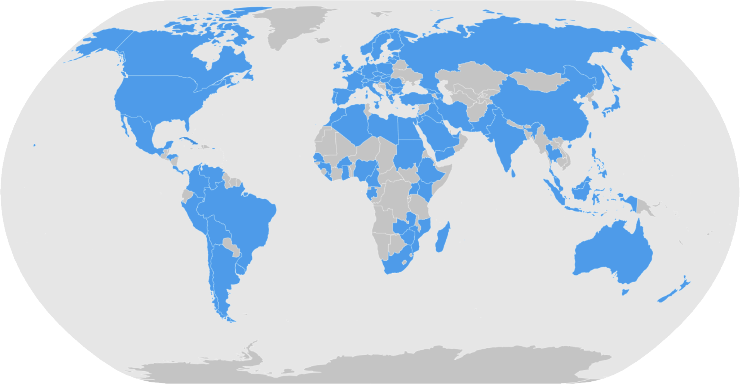
VoicePrint’s global reach

Slide 10
VoicePrint users include:

Slide 11
Our proposal to you
Notes:
Please tailor this slide to your client and pitch

